Slide 1
CS 4530: Fundamentals of Software Engineering Module 6, Lesson 1 Security
Rob Simmons
Khoury College of Computer Sciences

Slide 2
Warmup: what’s wrong with how security.town does passwords?

Slide 3
Warmup: what should we do about passwords?
Common responses: make sure passwords that we store stay on the server
But we also maybe shouldn’t have the passwords
That may mean we give someone else the passwords and never keep them on our server.
That may also mean we store something that’s not the password.
Notes:
Give it to someone else — almost always the right move for credit card numbers! But not for

Slide 4
Cryptographic Primitive #1: Hash
square(-4.5) = 20.25
Exactly two real numbers could have produced that output
You can easily find the other one
You can easily find x such that square(x) = 28.25 easily
sha256(“password”) = 5e884898da28047151d0e56f8dc6292773603d0d6aa…
(Probably) infinitely many strings could have produced that output
You cannot easily find another one
You cannot easily find x such that sha256(x) = 5e984898da2804715…

Slide 5
Cryptographic Primitive #1: Hash
There’s like, a couple dozen good cryptographic hashes out there. You should know about a like, six:
MD4 — run screaming from anyone who uses this for anything besides, like, a hashtable
MD5, SHA-0 — don’t use these
SHA-1 — some issues for some applications, but like, git works because this is fine
SHA-256 — Bitcoin does its thing because this is fine
SHA-most-anything-else — fine-to-overkill

Slide 6
Warmup: what should we do about passwords?
Common responses:
But we also don’t have to store the passwords
That may mean we give someone else the passwords and never keep them on our server.
That may also mean we store something that’s not the password.
Storing the sha256(password) means that even if someone gets everything on our server, they can’t easily find anyone’s password… right?
Notes:
Give it to someone else — almost always the right move for credit card numbers! But not for

Slide 7
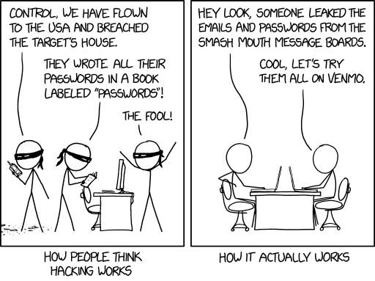
Warmup: what should we do about passwords?
…also, let’s compute the sha256 of all of them and add them to our rainbow table: people reuse passwords
https://xkcd.com/2176/

Slide 8
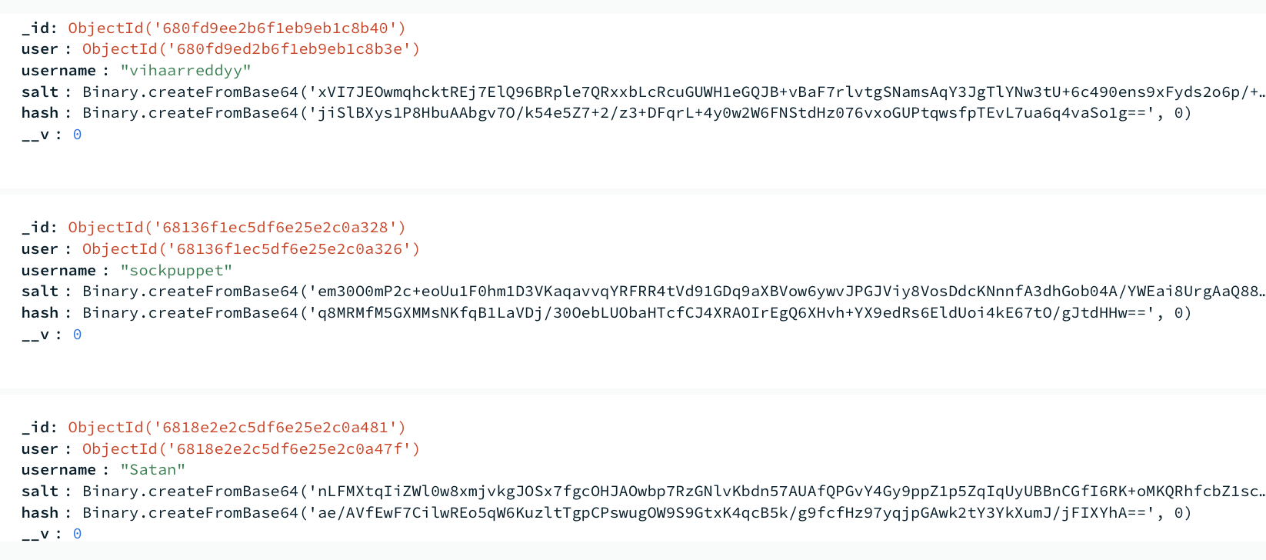
Warmup: what should we do about passwords?
To check auth, check if sha256(salt + password) = hash

Slide 9
Security Principle #1: Use an established solution
Special case of this principle is “never roll your own crypto”

Slide 10
Security is all over the SE map
PEOPLE
PROCESSES
PROGRAMS
Security
PLANNING
ORGANIZING
implementing

Slide 11
Learning Objectives for this Lesson
By the end of this lesson, you should be able to:
Explain why you should always hash and salt your passwords
Have basic literacy in some key cryptographic primitives (hashes, message authentication codes, and encryption)
Define key terms (attack surface, threat model) relating to software/system security
Explain why all aspects of software engineering are necessary to think about in order to think about security

Slide 12
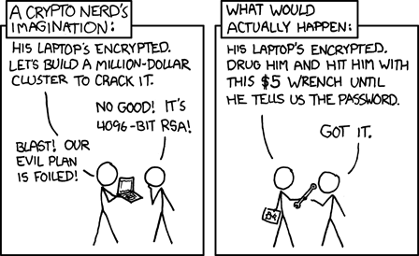
Security is a multiplayer game
The threat model specifies the rules you imagine that the other person is playing by
Strategy.town has radically different applicable threat models than, say, Signal
The attack surface specifies where the other player gets to play the game
https://xkcd.com/538/

Slide 13
Security is a multiplayer game
Simple threat model and attack surface: on the web, an attacker can make arbitrary requests to any API endpoints and send arbitrary messages over websockets, and can directly interpret every message that comes from the server.
Obvious consequences:
Don’t put secrets in a game’s View type (the fact that it’s not shown in React isn’t sufficient!)
Validate that it’s your turn on the backend (disabling the “make move button” in React isn’t sufficient!)

Slide 14
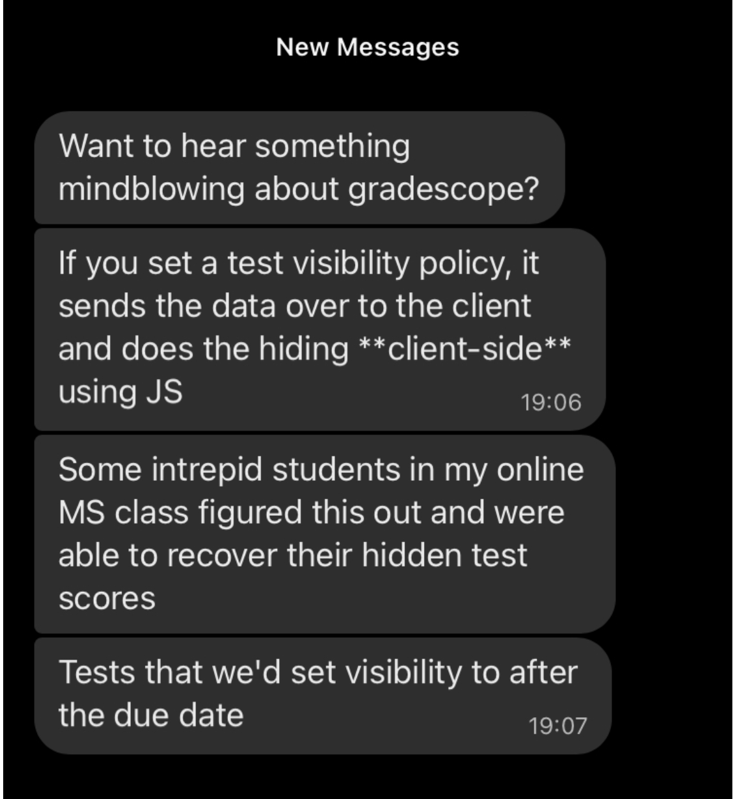
Security is a multiplayer game
Obvious consequences frequently are not:
Notes:
Question: should Brilliant be concerned if their quizzes use frontend-only verification that the user solved the problem?
Question: how can lockdown browser possibly work if these are the rules?

Slide 15
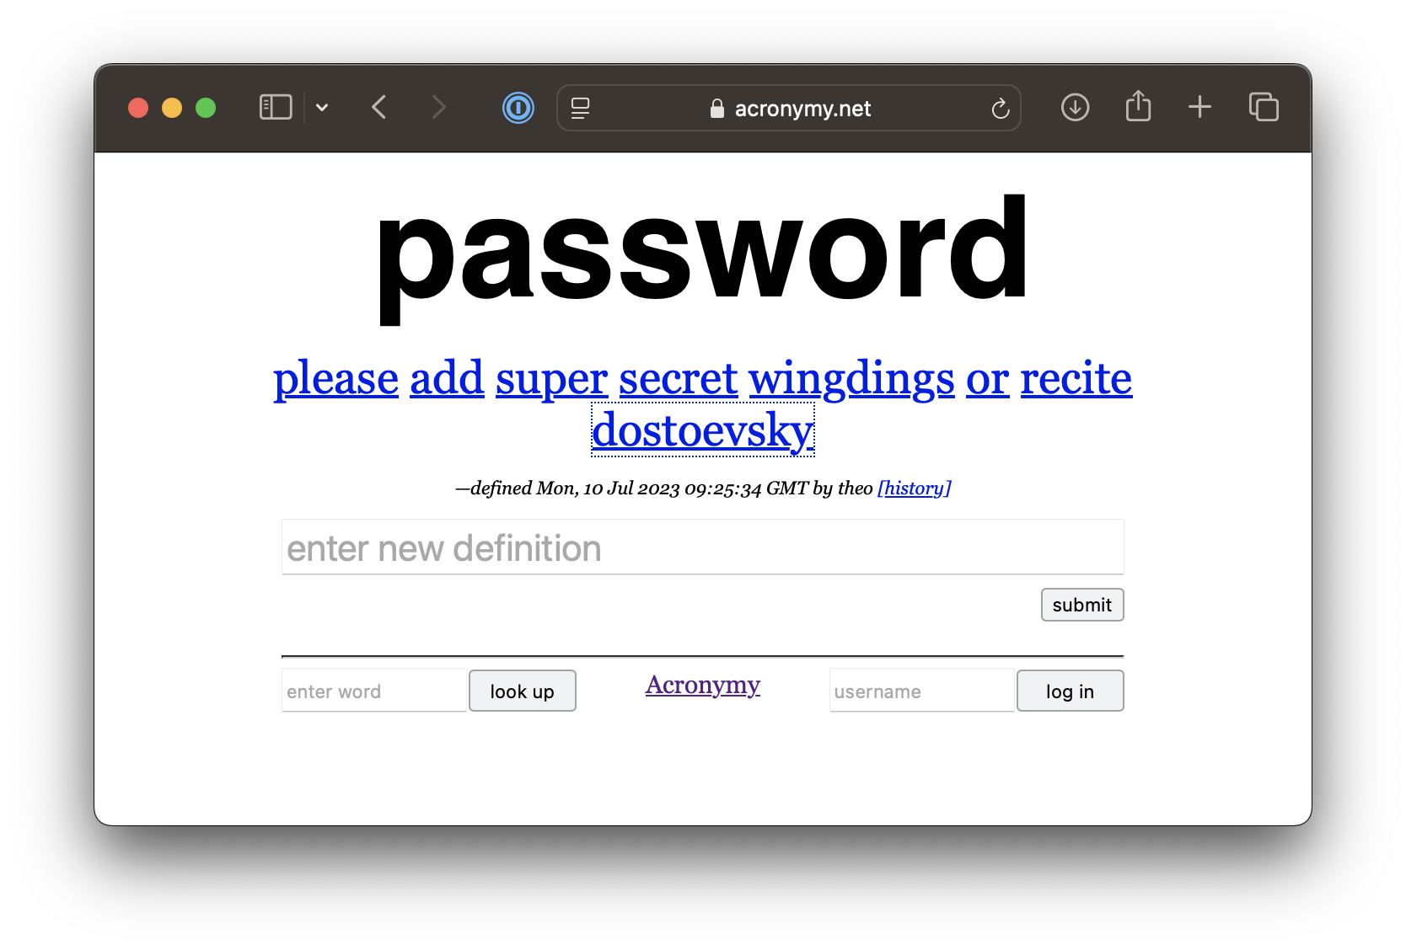
Security is a multiplayer game
Keep an eye on which game you are playing
Notes:
Acronymy is a collaborative effort to define all English words in terms of acroynms. It allows anonymous submissions and the login is only there for leaderboard tracking, so there’s not historically been enough incentive to implement passwords. You could absolutely define words “as me” by logging in as simrob, but what’s the point? Also please don’t or my friend David who runs the site and whose wedding I co-officiated will be annoyed with me.

Slide 16
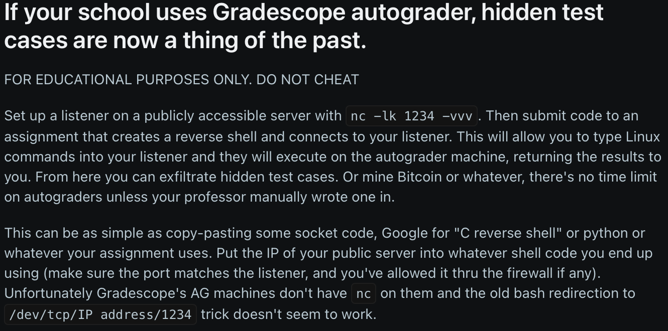
Security Principle #2: Watch for new attack surfaces
“Reverse shells” make a new attack surface
https://www.reddit.com/r/csMajors/comments/rlkf55/if_your_school_uses_gradescope_autograder_hidden/

Slide 17
Security Principle #2: Watch for new attack surfaces
Code and SQL injection is a new attack surface
Don’t roll your own solution — use established library! (Zod, Mongoose…)
https://xkcd.com/327/

Slide 18
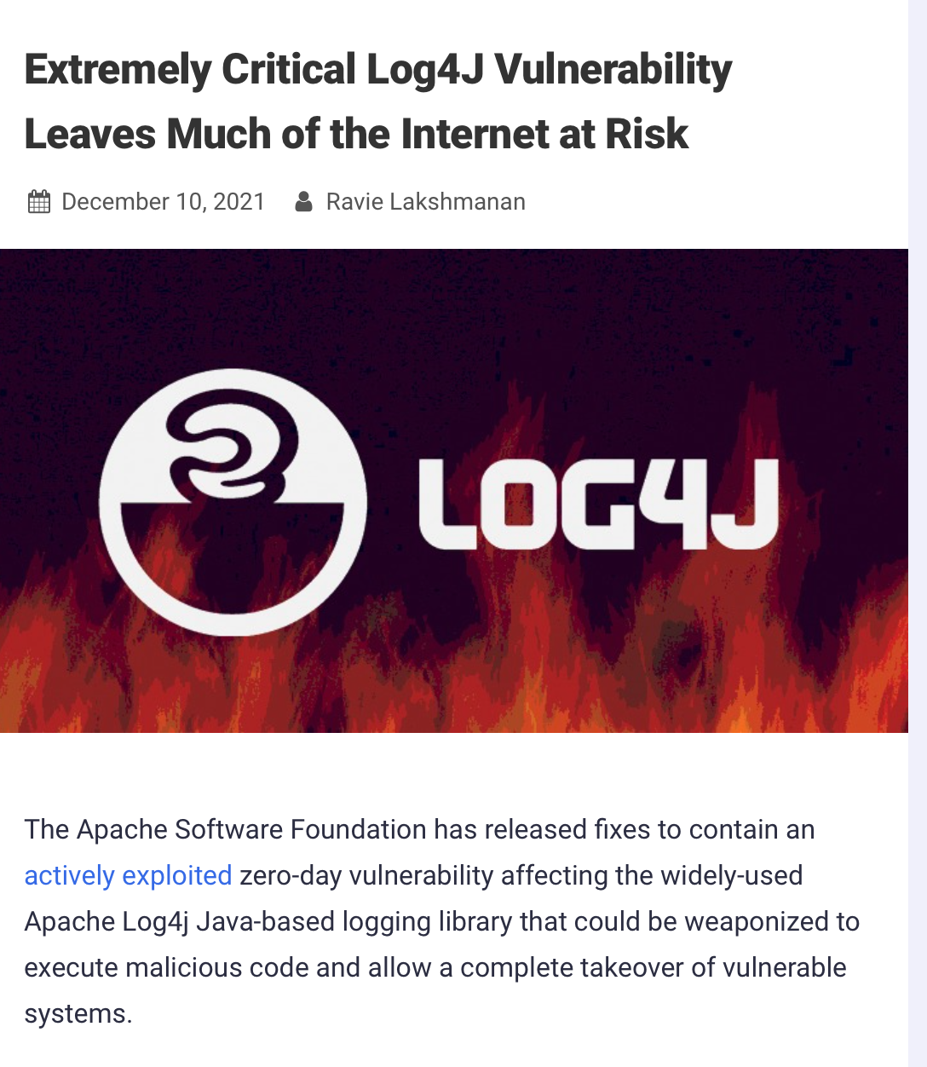
Security Principle #2: Watch for new attack surfaces
Log4J could trigger arbitrary HTTP requests from places that weren’t supposed to be able to make HTTP requests
CVE-2021-44228 Detail
Current Description
Apache Log4j2 2.0-beta9 through 2.15.0 (excluding security releases 2.12.2, 2.12.3, and 2.3.1) JNDI features used in configuration, log messages, and parameters do not protect against attacker controlled LDAP and other JNDI related endpoints. An attacker who can control log messages or log message parameters can execute arbitrary code loaded from LDAP servers when message lookup substitution is enabled. From log4j 2.15.0, this behavior has been disabled by default. From version 2.16.0 (along with 2.12.2, 2.12.3, and 2.3.1), this functionality has been completely removed. Note that this vulnerability is specific to log4j-core and does not affect log4net, log4cxx, or other Apache Logging Services projects.
https://nvd.nist.gov/vuln/detail/CVE-2021-44228
https://thehackernews.com/2021/12/extremely-critical-log4j-vulnerability.html

Slide 19
Security Principle #3: Beware the man in the middle
You and Amazon can’t actually see each other. How do you know you’re interacting with Amazon?
Amazon
Website
Amazon
API
Copy of
Amazon
Website
Human User
Additional
API

Slide 20
Security Principle #3: Beware the man in the middle
With CORS, Amazon’s API tells the web browser: ignore my response unless the user is on amazon.com
Amazon
API
Copy of
Amazon
Website
Human User
Additional
API

Slide 21
Security Principle #3: Beware the man in the middle
Proxying those requests gives Amazon’s website more opportunities to notice something is wrong
You may need to use proxying to deal with CORS in your projects!
!!!
Amazon
API
Copy of
Amazon
Website
Human User
Proxy
API

Slide 22
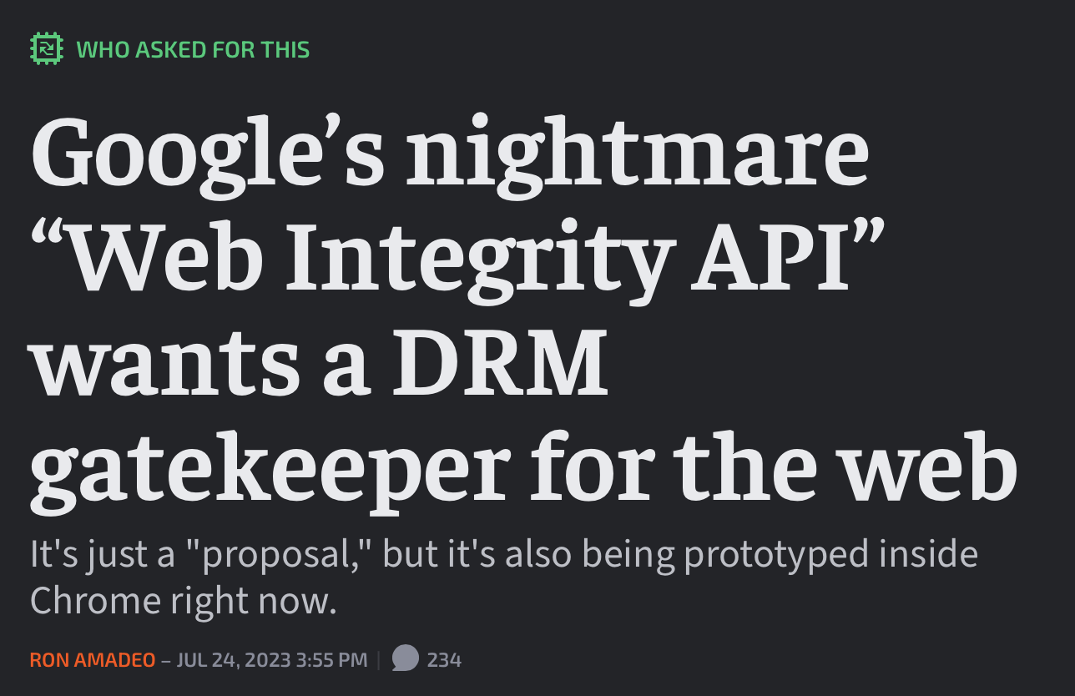
Browsers are Fascinating
Influenced by browser makers, consumer choices, standards bodies, online businesses…
CORS works because ~everyone would rather have CORS in their browser (but remember your threat model!)
Browser monopolies arise and change the balance of power
https://arstechnica.com/gadgets/2023/07/googles-web-integrity-api-sounds-like-drm-for-the-web/

Slide 23
Browsers are Fascinating: Cookies
Cookies add sessions to HTTP requests — the login API end point can set a cookie and subsequent HTTP requests will send it back.
If JavaScript has no business viewing the cookie, it can be an HTTP ONLY cookie — code can’t see it
BUT THE USER CAN! (Remember your threat model!!!)
Makes it unnecessary to send (and verify!) the password every time.
Of course, it’s also how Facebook knows what jobs you applied for…

Slide 24
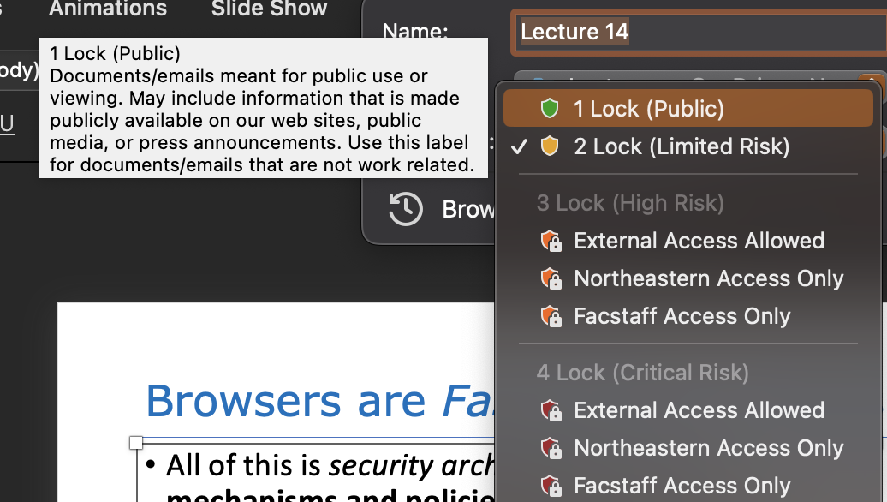
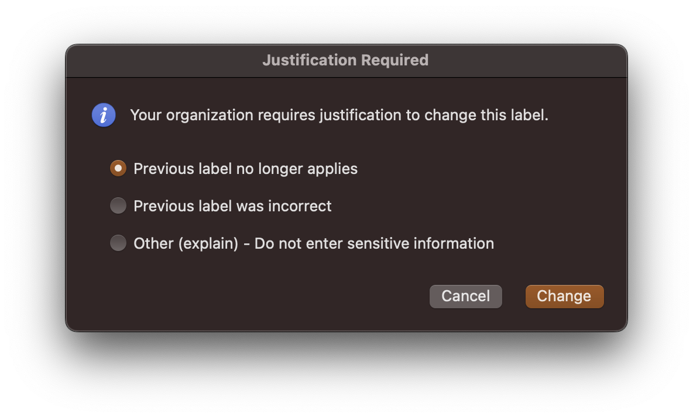
Security Architecture
CORS and HTTP ONLY cookies are part of the security architecture of browsers— the mechanisms and policies that we build into our system to mitigate threats

Slide 25
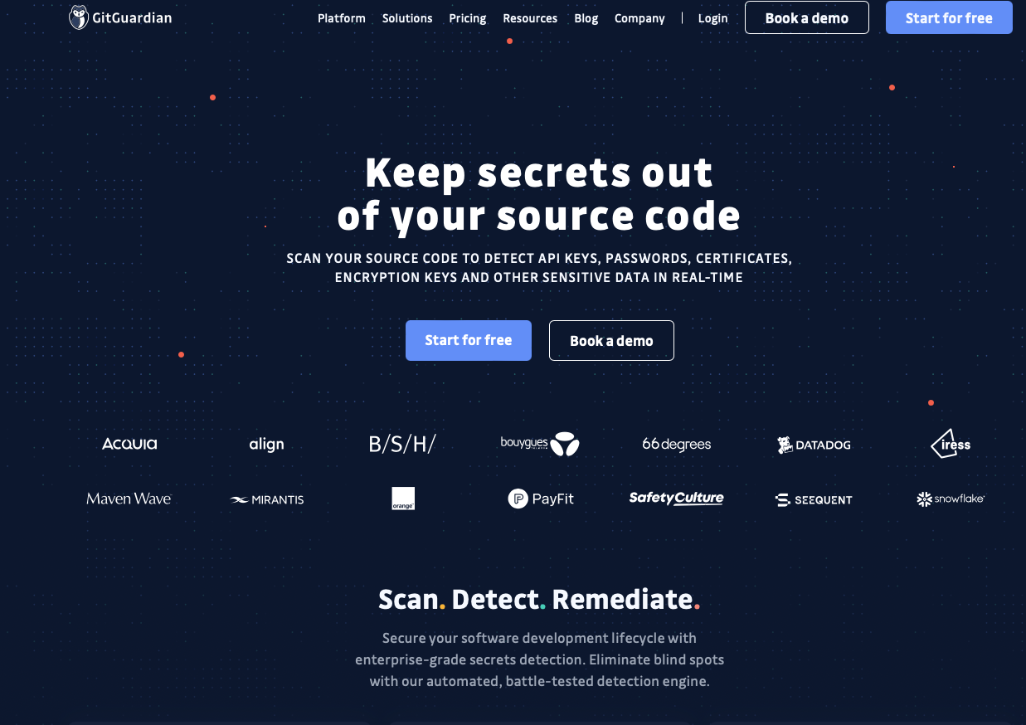
Security Architecture and Security Culture
Don’t check API keys (basically passwords someone else generates for you) into git, ever!
Tools like GitGuardian automatically detect secrets in repositories

Slide 26
Security Architecture and Security Culture
Industrial study of secret detection tool in a large software services company with over 1,000 developers, operating for over 10 years
What do developers do when they get warnings of secrets in repository?
49% remove the secrets; 51% bypass the warning
Why do developers bypass warnings?
44% report false positives, 6% are already exposed secrets, remaining are “development-related” reasons, e.g. “not a production credential” or “no significant security value”
Is this a problem? Whose problem is it?

Slide 27
Cryptographic Primitive #2: Signing
Your server can have a secret key (just a random one)
If you compute sha256(secret + message) = hash, then give the message AND the hash to someone else, they can hand you back the message and the hash later, and you can believe “you” (someone who knew the secret) agreed to compute that hash — no one else could!
The hash is an HMAC: a Hash Message Authentication Code
Sign message “this is user2”: that plus the HMAC is your cookie!
Notes:
Don’t roll your own hmac by computing sha256(secret + message), use a library function that creates an HMAC

Slide 28
Cryptographic Primitive #2: Signing
Public key encryption allows asymmetric signing
Paired public key and private key
Anyone with the public key can verify that a message was signed only by someone with the private key
One basis of the security of HTTPS
Amazon
Website
“I’m totally Jeff Bezos”
Signed, the person with private key that matches
Amazon public key
Amazon private key
Amazon public key
Human User
Amazon public key

Slide 29
Security Principle #4: Chains and webs of trust
Your browser or computer shipped with some public keys:
Google Trust Services LLC (GTS Root R4) public key
Internet Security Research Group (ISRG Root X1) public key
DigiCert High Assurance EV Root CA public key

Slide 30
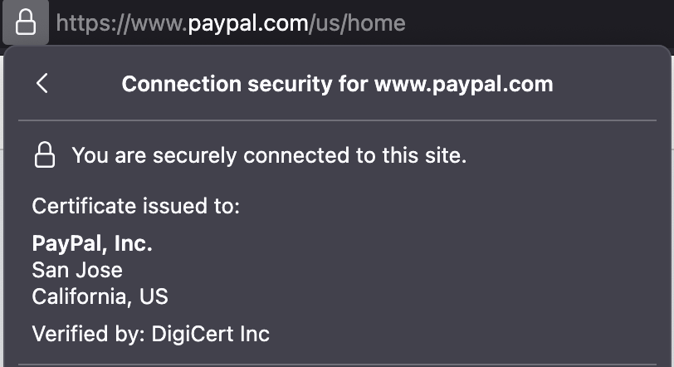
Security Principle #4: Chains and webs of trust
DigiCert High Assurance EV Root CA private key holder
Signs the message “Whoever has the private key matching DigiCert SHA2 Extended Validation Server CA public key seems legit and is a certificate authority”
DigiCert SHA2 Extended Validation Server CA private key holder
Signs the message “Whoever has the private key matching paypal.com public key is definitely associated with the legal entity PayPal.com, but is not a certificate authority”
www.paypal.com private key holder
Signs the message “Hi, if you think you’re connecting to https://www.paypal.com/, would you like to give me your password?”

Slide 31
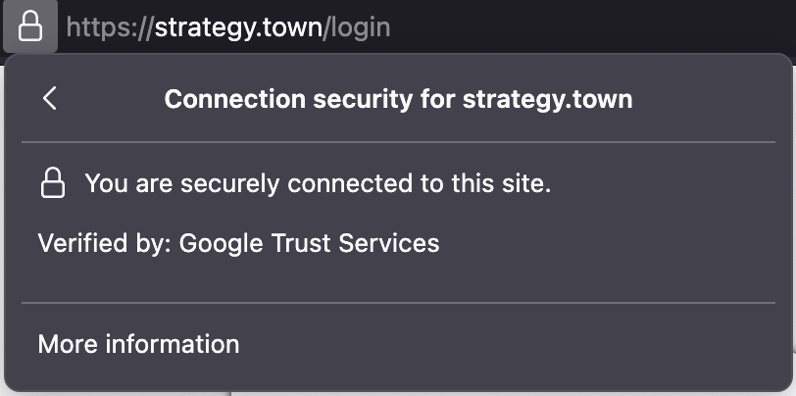
Security Principle #4: Chains and webs of trust
Google Trust Services LLC (GTS Root R4) private key holder
Signs the message “Whoever has the private key corresponding to Google Trust Services (WE) public key seems legit and is a certificate authority”
Google Trust Services (WE) private key holder
Signs the message “Whoever has the strategy.town private key seems legit associated with that domain, but not as a certificate authority”
strategy.town private key holder
Signs the message “Hi, if you think you’re connecting to https://strategy.town/, would you like to give me your password?”

Slide 32
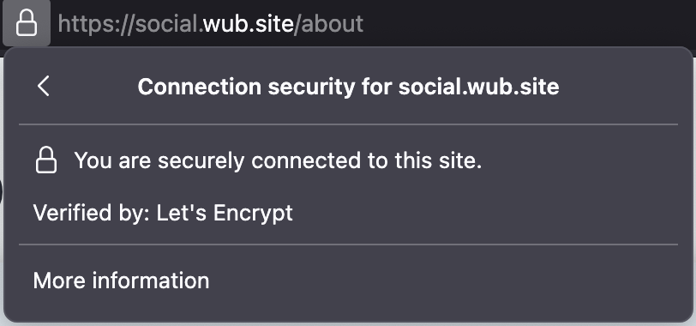
Security Principle #4: Chains and webs of trust
Internet Security Research Group (ISRG Root X1) private key holder
Signs the message “Whoever has the private key matching Let's Encrypt (R10) private key seems legit and is a certificate authority”
Let's Encrypt (R10) private key holder
Signs the message “Whoever has the private key matching social.wub.site public key seems legit associated with that domain, but not as a certificate authority”
social.wub.site private key holder (that is, Rob)
Signs the message “Hi, if you think you’re connecting to https://social.wub.site/, would you like to give me your password?”

Slide 33
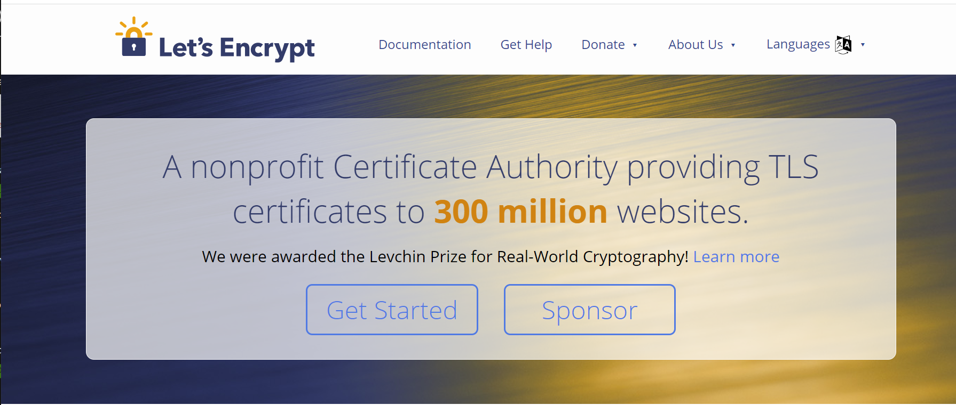
Security Principle #4: Chains and webs of trust
You can do this on your own server for free
This wasn’t the case before the Let’s Encrypt nonprofit!

Slide 34
Security Principle #4: Chains and webs of trust
I need to get SOMEONE the user trusts to vouch that I’m strategy.town
Skechy
Wifi
Network
Not
Strategy
town
I would like
to connect
to strategy.town
Strategy
town

Slide 35
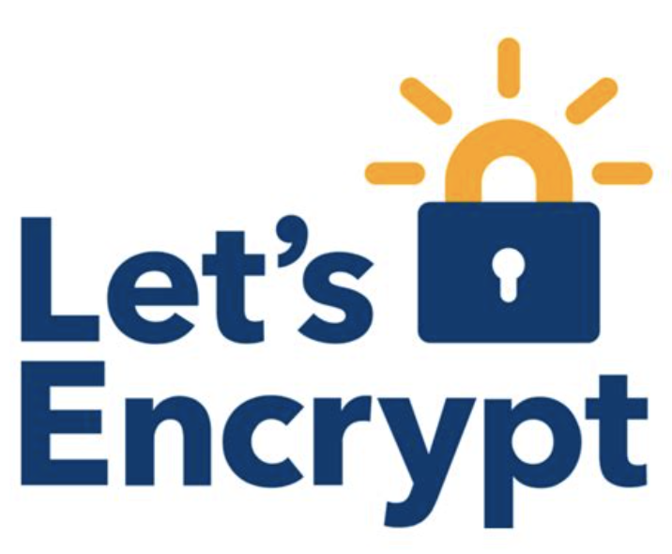
Security Principle #4: Chains and webs of trust
I need to get SOMEONE the user trusts to vouch that I’m strategy.town
Let’s Encrypt is vouching for anyone IT SEES as the strategy.town owner
Skechy
Wifi
Network
Not
Strategy
town
I would like
to connect
to strategy.town
Hopefully
Less
Sketchy
Internet
Strategy
town

Slide 36
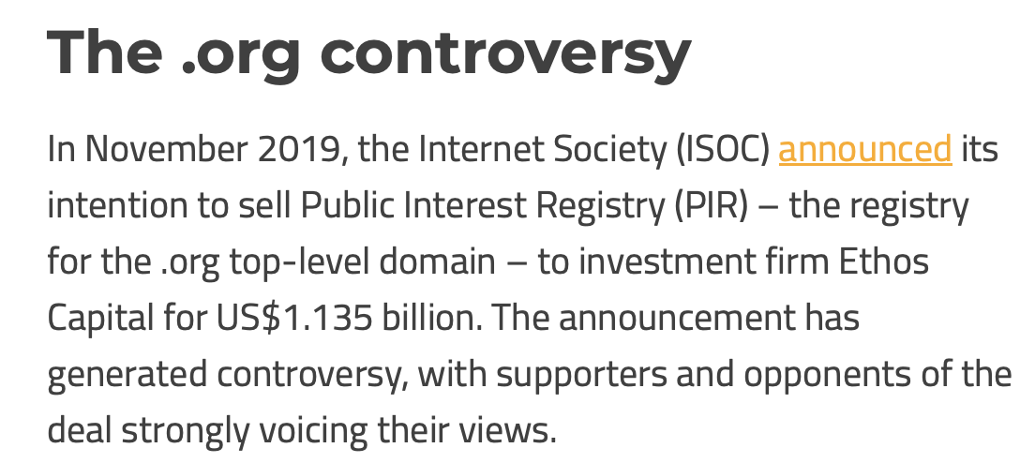
Security Principle #4: Chains and webs of trust
Modern TLS/HTTPS security relies on the security of the domain name system
The DNS system has its own security issues and threat models!
https://dig.watch/trends/dotorg

Slide 37
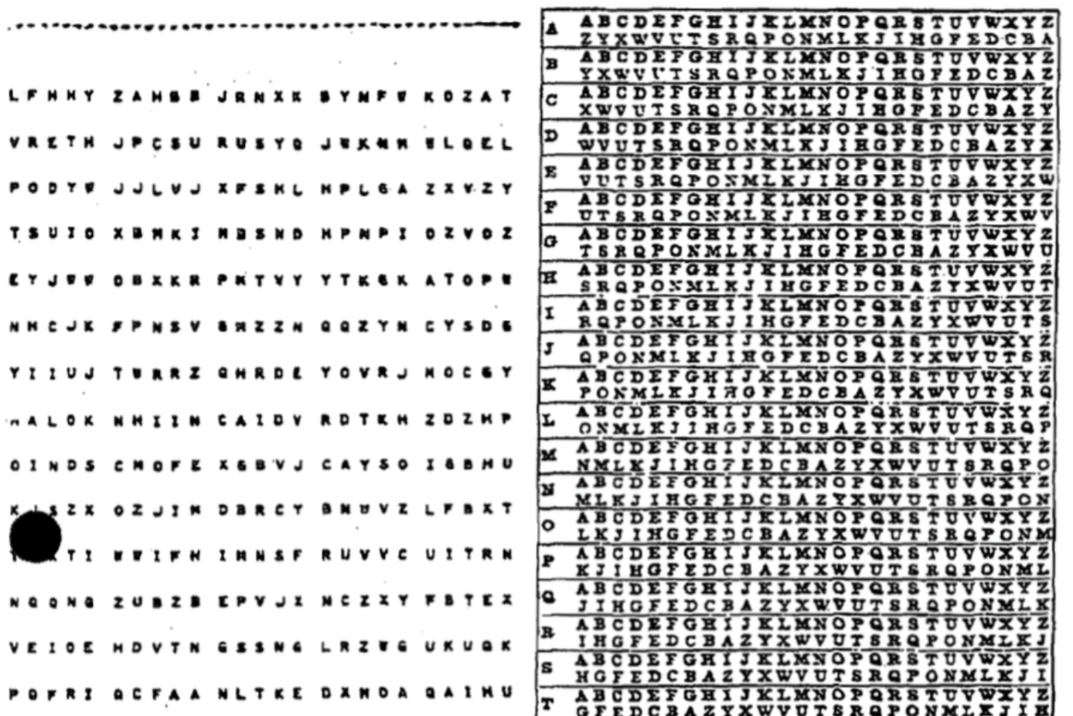
Cryptographic Primitive #3: Shared secret encryption
Absolutely perfect security via one-time pads
You and I both have n TRULY RANDOM bytes X
You send me X xor Message
I decode message by computing (X xor Message) xor X = Message
ONLY FOR ONE TIME!!!
https://en.wikipedia.org/wiki/One-time_pad

Slide 38
Cryptographic Primitive #3: Shared secret encryption
There are a couple of reasonably secure symmetric encryption standards
Use a small shared secret to encrypt lots of data
We think most of the ones we currently use are pretty secure, even against quantum computers
Problem: how do share a secret with Amazon?
Amazon
Website
Human User
Amazon private key
Amazon public key
Amazon public key

Slide 39
Cryptographic Primitive #3: Shared secret encryption
Problem: how do share a secret with Amazon?
If two people know two public keys and either one of the corresponding private keys, they can do math to come up with a shared secret, and use that for symmetric encryption!
Textbook ways of doing this are very vulnerable to quantum computers
Rando public + Amazon pubic + Rando private = some huge number
Rando public + Amazon pubic + Amazon private = SAME huge number
Amazon
Website
Hi i’m a rando, here’s my Rando public key
Human User
Amazon private key
Amazon public key
Amazon public key
Rando private key
Rando public key

Slide 40
Review of this whirlwind tour
Four big ideas Rob thought were worth emphasizing:
Use an established solution
Watch for new attack surfaces
Beware the man in the middle
It’s all chains and webs of trust
Three cryptographic primitives you should be aware of:
Hash
Signing/message authentication codes
Shared secret encryption

Slide 41
Learning Objectives for this Lesson
Now that it’s the end of the lesson, you should be able to:
Explain why you should always hash and salt your passwords
Have basic literacy in some key cryptographic primitives (hashes, message authentication codes, and encryption)
Define key terms (attack surface, threat model) relating to software/system security
Explain why all aspects of software engineering are necessary to think about in order to think about security

